Slide 1
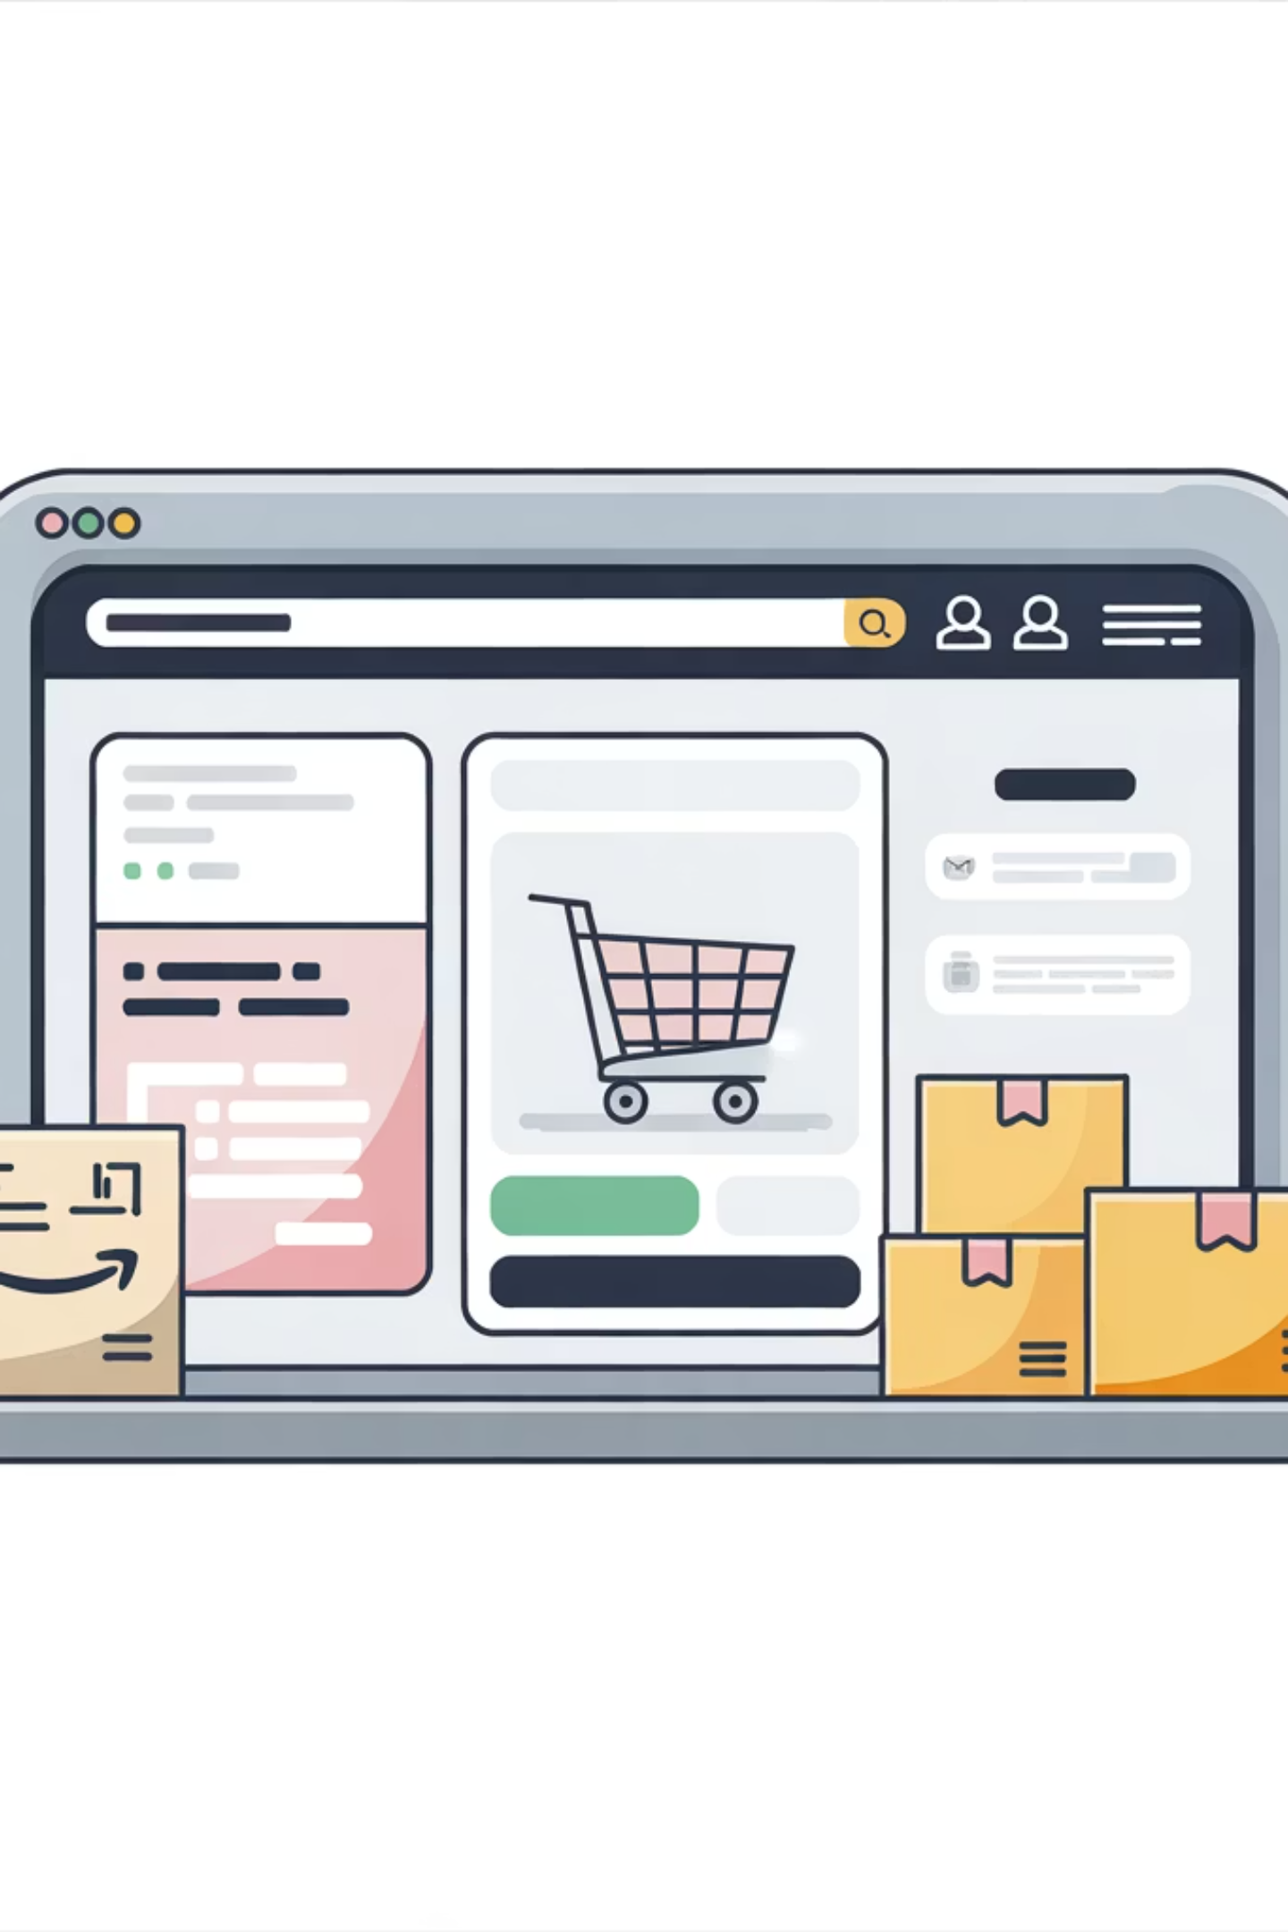
Customer Shopping Behavior Analysis
Uncovering spending patterns, customer segments, and product preferences from 3,900 transactions to guide strategic business decisions.

Slide 2
Dataset at a Glance
This dataset reveals critical patterns in customer behavior, revenue drivers, and product performance — let's explore what the data tells us.
Transactions
Features
3,900
18
Rows in dataset
Columns analyzed
Avg Purchase
Avg Rating
$59.76
3.75
Mean spend per order
Out of 5 stars
Customer Demographics
Purchase Behavior
Age, Gender, Location, Subscription Status
Item, Category, Amount, Season, Discount, Frequency, Review Rating

Slide 3
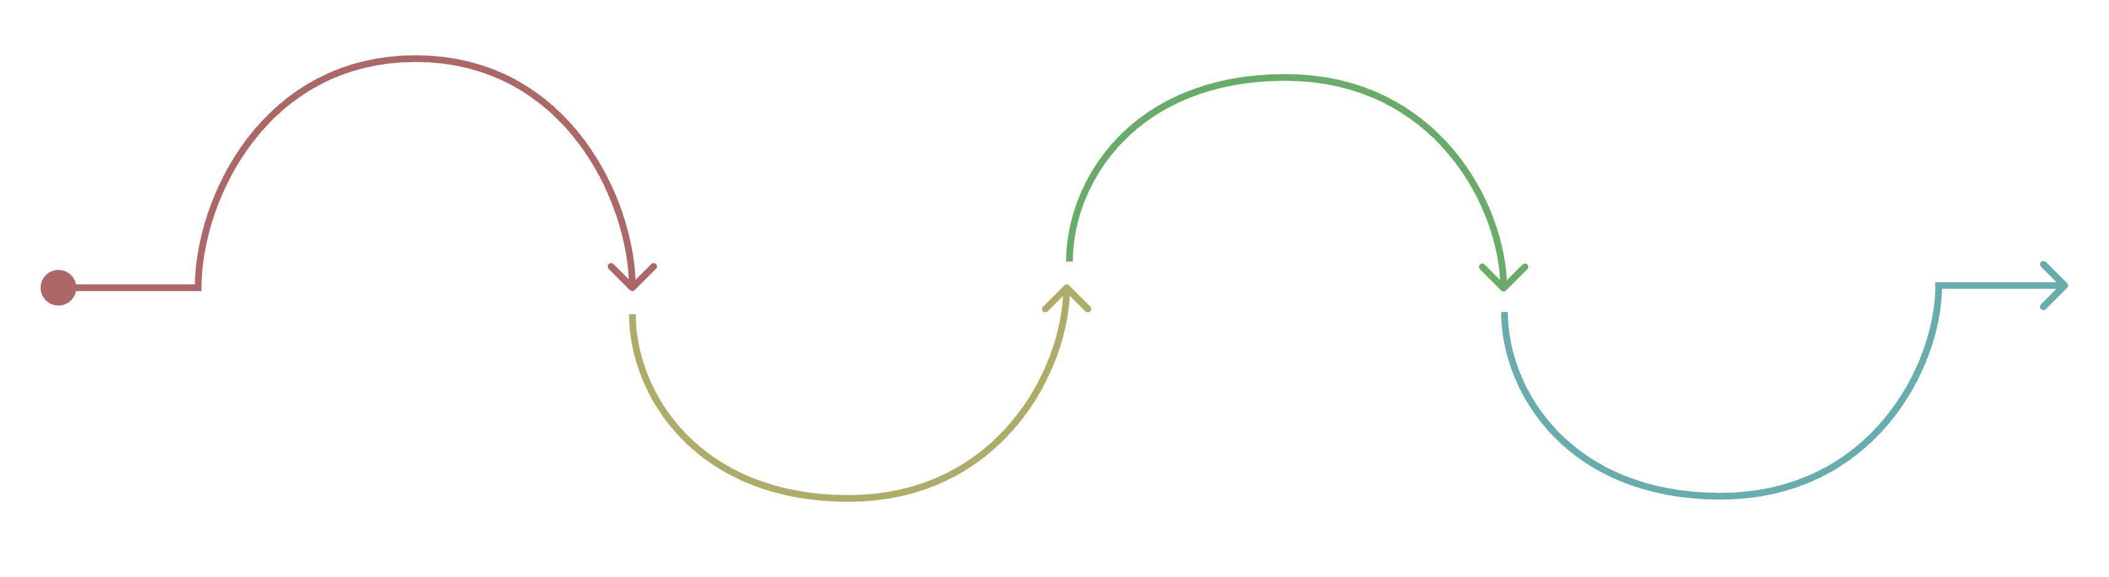
Data Pipeline: From Raw Data to Insights
Load to PostgreSQL
Clean & Standardize
Load & Explore
Engineer Features
Python handled data preparation and cleaning; the cleaned DataFrame was loaded into PostgreSQL for structured business analysis.

Slide 4
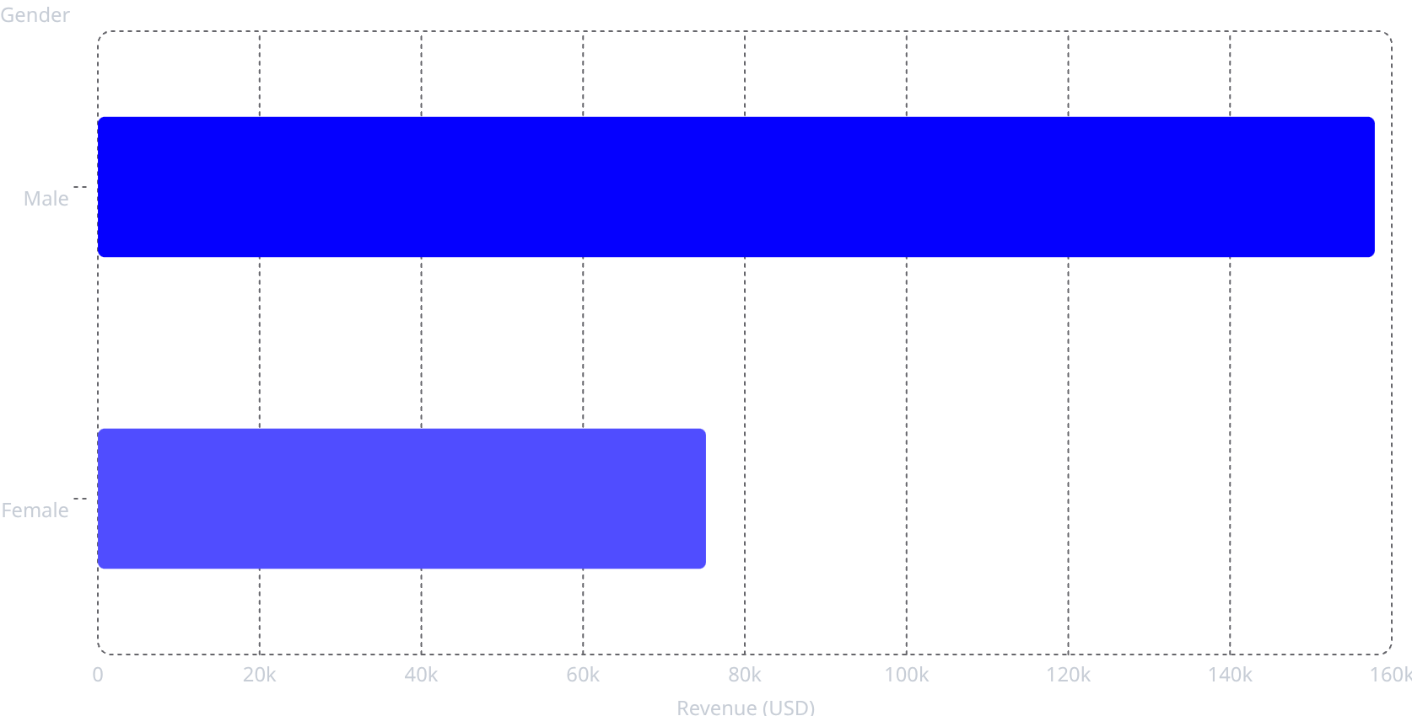
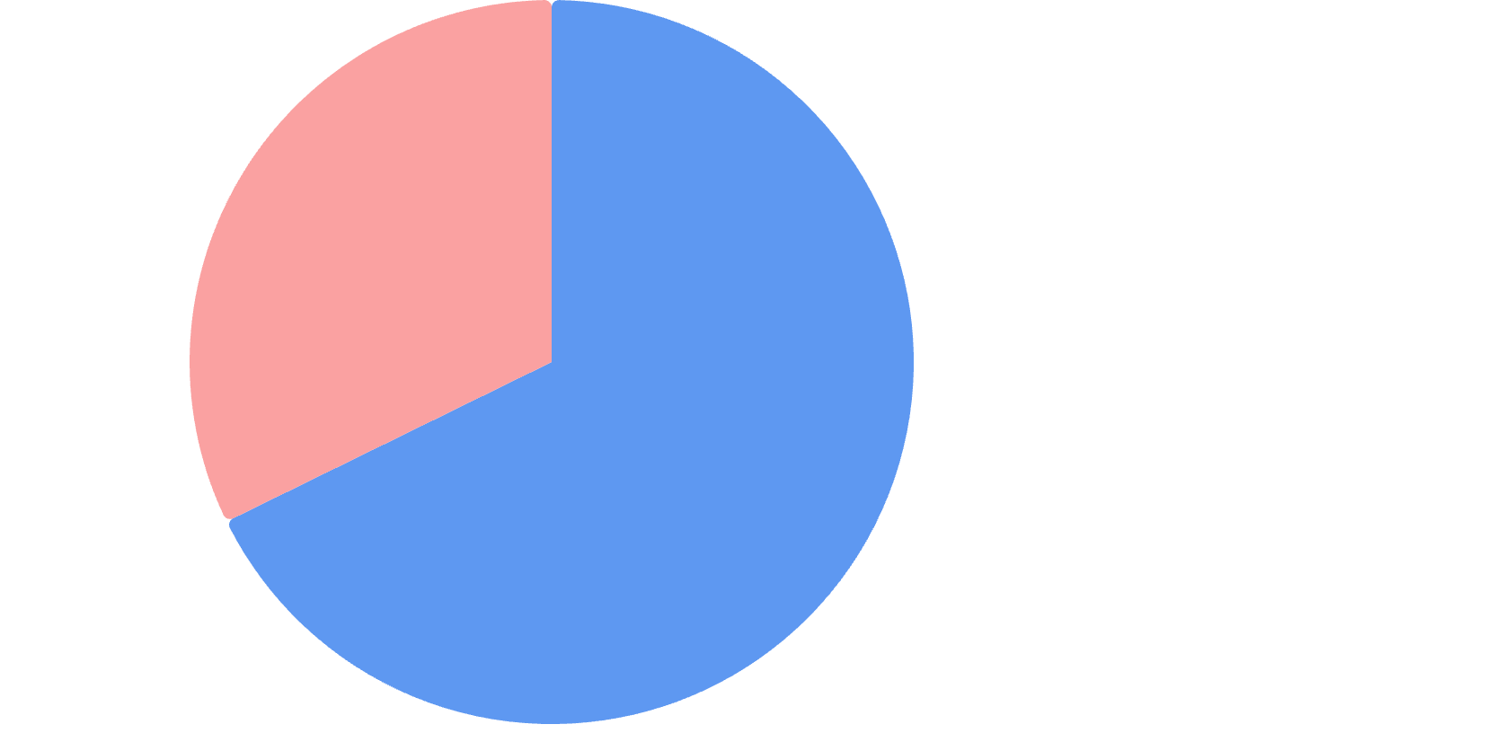



Revenue & Customer Segments
Male·67.74%
·67.74%
·
Female·32.26%
·32.26%
·
Male customers generate 2.1× more revenue than female customers — a key segment to understand and engage.
Loyal Customers
Returning
New Customers
3,116 — the dominant segment
701 customers
Only 83 — growth opportunity

Slide 5
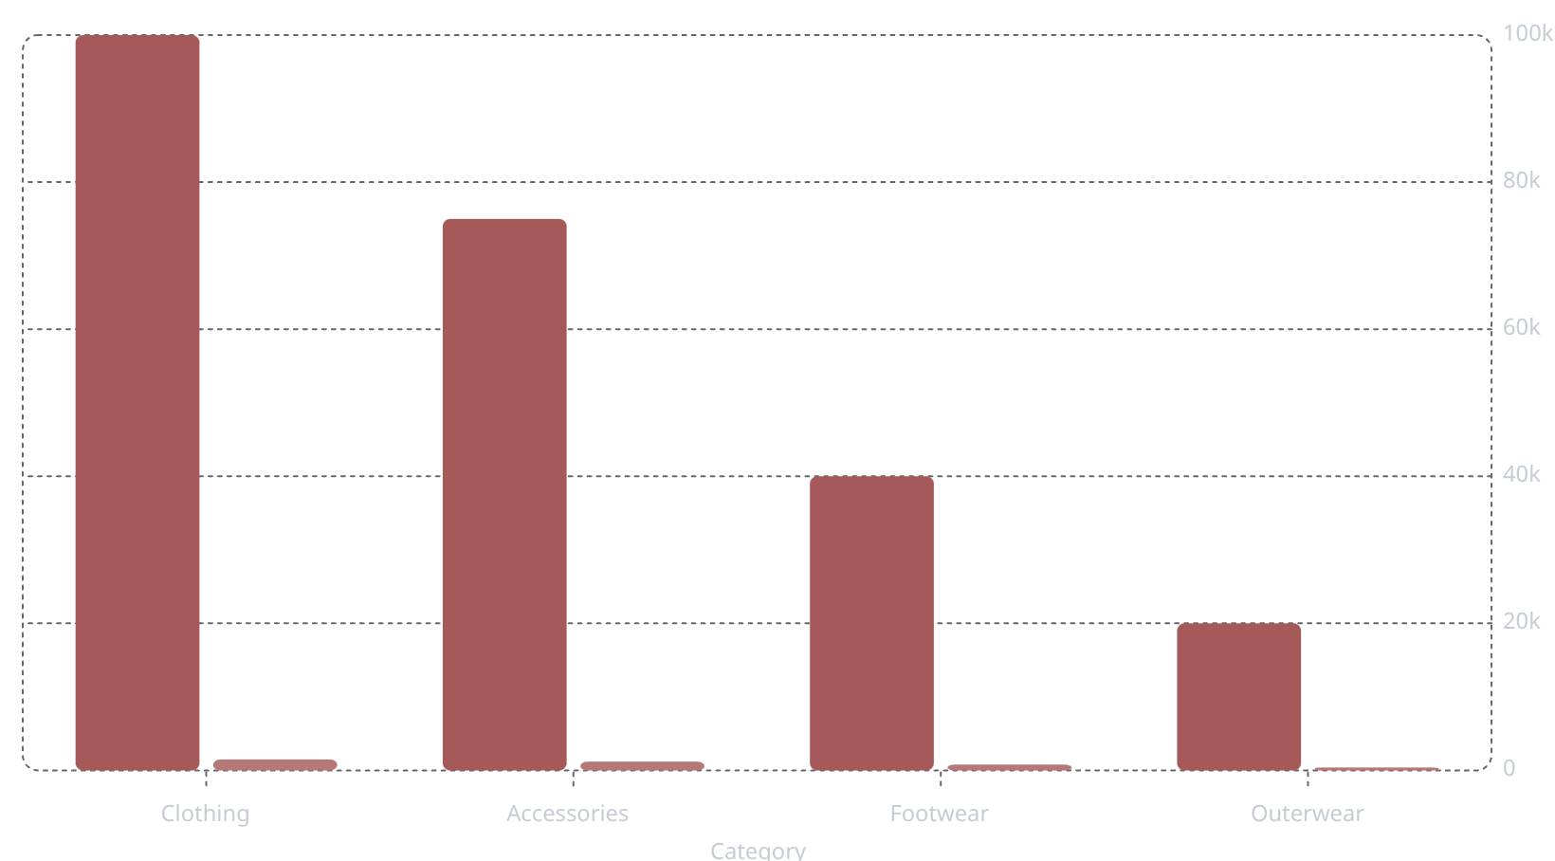
Product & Category Performance
Revenue (USD)
Sales Count
Top 3 Products per Category
Clothing: Blouse, Pants, Shirt
Accessories: Jewelry, Sunglasses, Belt
Footwear: Sandals, Shoes, Sneakers
Outerwear: Jacket, Coat
Clothing and Accessories dominate — ~70% of total revenue.

Slide 6
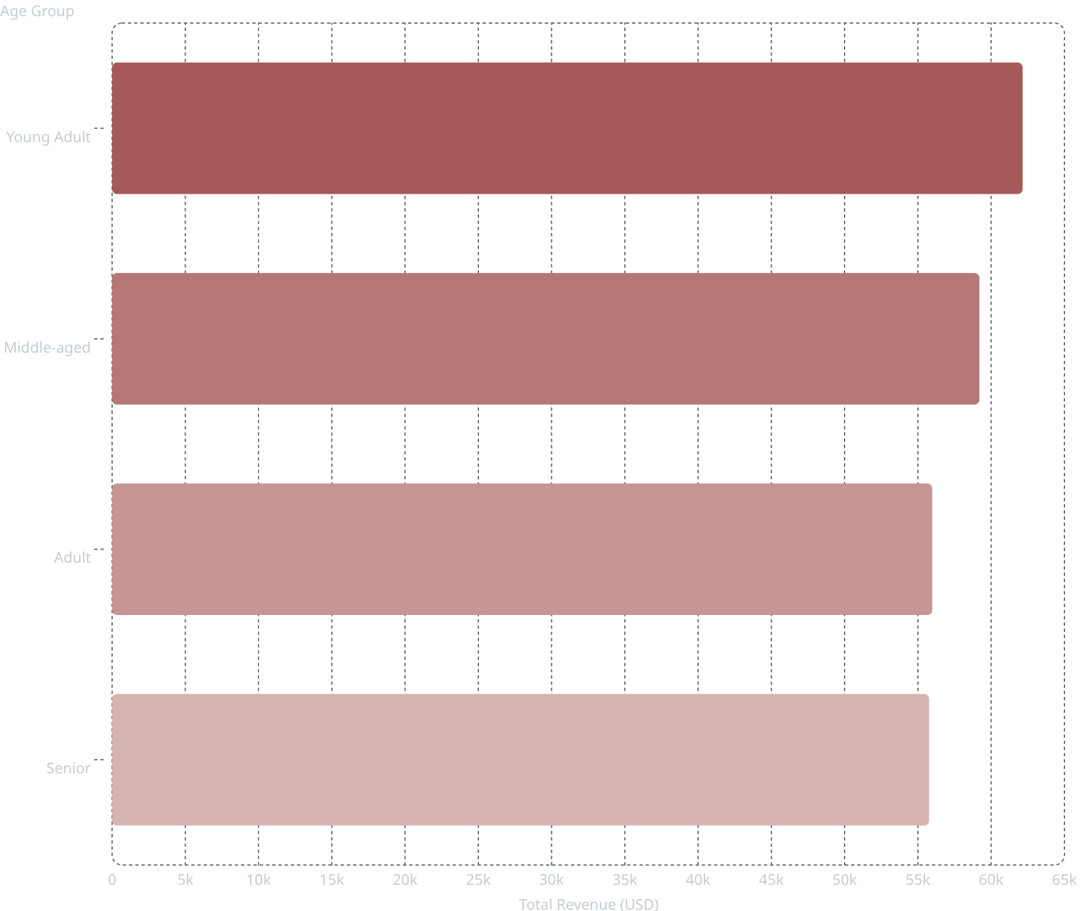
Subscription, Discounts & Age Insights
Subscription Impact
Subscribers: 27% of customers generate $62,645 in revenue.
Non-subscribers: 73% of customers generate $170,436 in revenue.
This shows a clear conversion opportunity among non-subscribers.
Discount-Dependent Products
Hat — 50% discount rate
Sneakers — 49%
Coat — 49%
Sweater — 48%
Pants — 47%

Slide 7
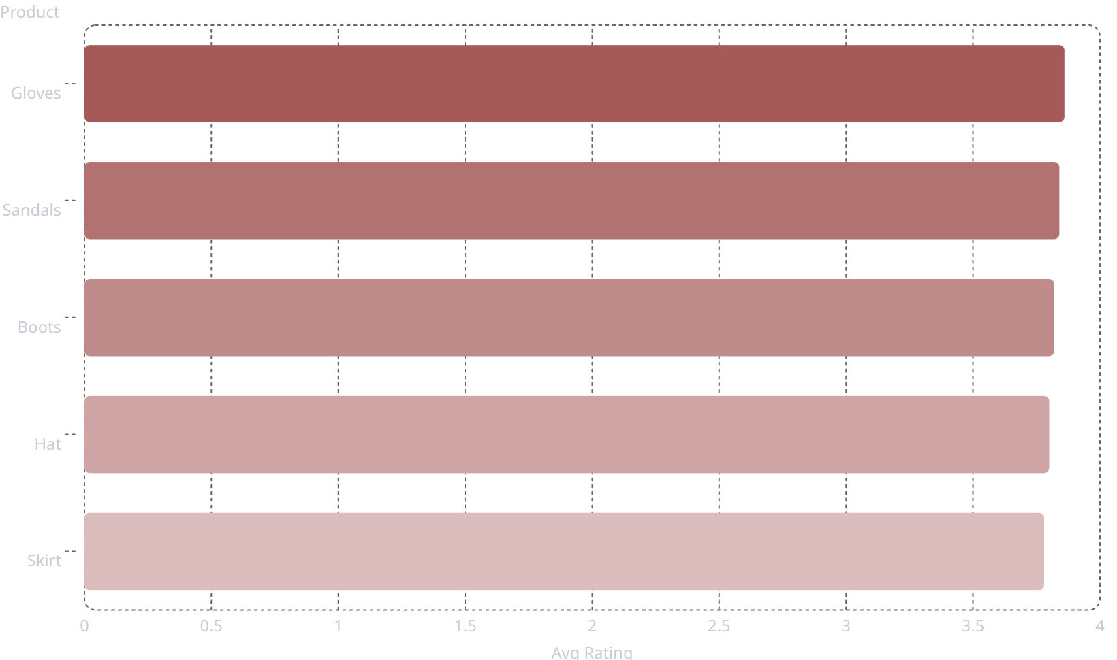

Top-Rated Products & Shipping Behavior
Shipping Type Comparison
Express shipping averages $60.48 vs. Standard at $58.46 — a $2.02 uplift per order for faster delivery.
High-rated products like Gloves and Sandals should be featured prominently in marketing to drive conversion.

Slide 8
Strategic Recommendations
Priorities to grow revenue, deepen loyalty, and improve performance.
Revenue Growth
Customer Engagement
Conversion & Efficiency
Prioritize Top Categories
Convert Repeat Buyers
Use Selective Discounts
Focus on Clothing & Accessories — they drive ~70% of revenue.
958 repeat buyers are unsubscribed — convert them to subscribers.
Apply discounts to Hat, Sneakers, and Coat only.
Impact: Concentrates spend where demand is strongest.
Maximizes near-term sales.
Impact: Builds recurring revenue.
Improves retention.
Impact: Protects margin.
Targets inventory more effectively.
Target Young Adults
Leverage Product Ratings
Promote Express Shipping
This segment generates the highest revenue.
Promote top-rated items and review low performers.
Push Express to lift average order value.
Impact: Improves relevance.
Boosts conversion and share of wallet.
Impact: Supports conversion.
Reduces friction from weak reviews.
Impact: Encourages premium fulfillment.
Drives higher order value.

